Slide 1
CSE 11
Accelerated Intro to Programming Discussion Section 6
Sachin Deshpande
Summer 1 2021
This discussion is being recorded

Slide 2
Logistics
PA6 Released, due Sunday
PA7 released early – start early!
Exam this week – see Piazza for details

Slide 3












For-in loops
run the body of their loops once per element in a given array
follows the order that they appear in the array, with the "loop variable" assigned to that element
Their syntax looks like:
for (/* element type */ /* variable name */: /* array */) {
/* loop body */
}
Example :
String[] messages = {"Hello", "CSE11"};
for (String message: messages) {
System.out.println(message);
}
prints
Hello CSE11

Slide 4







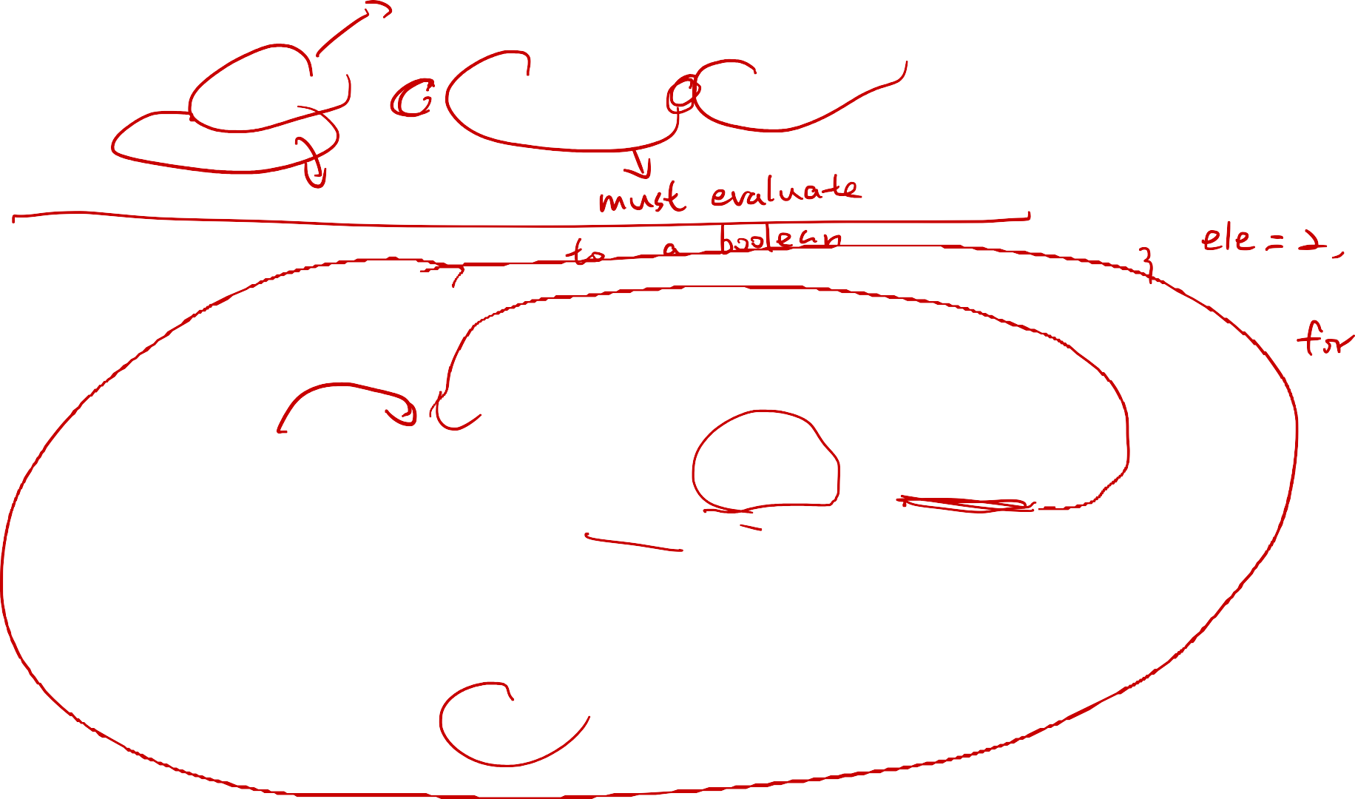













Counted for loops
More fine grained control compared to for-in loops - these are not limited to running once per element in an array
Their syntax looks like:
for (/* initializer */; /* condition */; /* update */) {
/* body */
}
|
˅
|
|
| body | -> | update | -
| initializer
| -> | condition
| false |
|
˅
(exit)
| -------> |
true

Slide 5






Counted for loops
body of counted for loops contain other can contain multiple Java statements, including multiple method calls, variable definitions and updates, if statements, and even other loops
// Start with the top header of the table
String result = "\t1\t2\t3\t4\t5\n";
for (int i = 1; i <= 5; i += 1) {
// Print the left header
result += i;
Prints the times table from 1 to 5 to the terminal:
1 2 3 4 5
1 1 2 3 4 5
2 2 4 6 8 10
3 3 6 9 12 15
4 4 8 12 16 20
5 5 10 15 20 25
// Print the row
for (int j = 1; j <= 5; j += 1) { result += "\t" + (i * j);
}
// Add a newline to finish the row
result += "\n";
}
System.out.println(result);

Slide 6

















Loop Basics
How to access elements in a very very long array?
Loops
For-loop
for (int i = 0; i < arr.length; System.out.println(arr[i]);
}
For-each loop
for (int element : arr){ System.out.println(element);
}
While loop
int i = 0;
while (i < arr.length){ System.out.println(arr[i]); i++;
}
i++){

Slide 7
















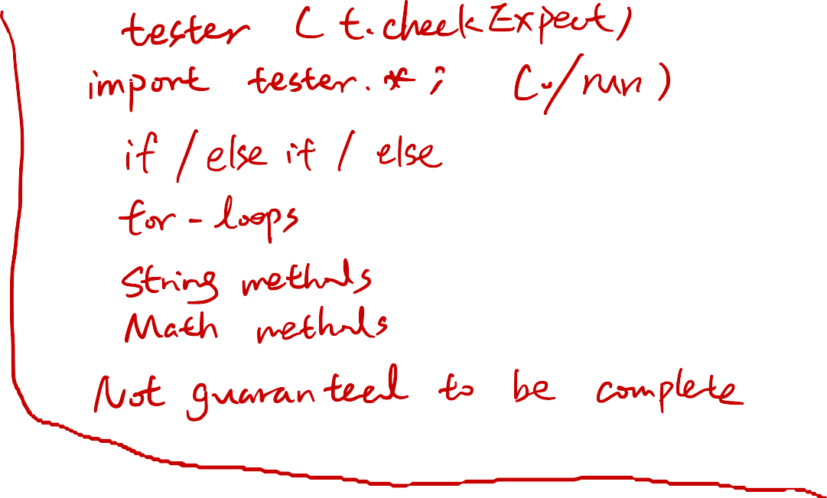

























Exam

Slide 8
PA 6&7
PA9 depends on PA7, which is why there is a higher cap on resubmission score

Slide 9
Thanks!

